Slide 1
Smart Adaptive Display Panel
Group Members: Ong Yi Xin, Lim Jun Wei, Chia Ming Yi
RSDY2S3G5

Slide 2
Description of System
Integrated with sensors
Brightness
Humidity
Temperature
Hand Gesture
NFC Reader
Smart, adaptive and automated
Helping and easing business people
Dynamic promotional content tailored to conditions
Digital Display Module
Cycles through promotional posters
Posters are uploaded and managed via a user-friendly interface

Slide 3
Description of System
Entrance Guard Functionality
Controls entrance access
Suitable for secure environments like apartment lobbies
Actionable Reporting Module
Analyzes historical data for strategic insights
Supports decision-making and improves operational efficiency

Slide 4
Targeted Users
Businessmen
Ideal for retail and customer-facing environments
Displays dynamic ads based on environment, time, and gestures
Gesture control increases user interaction and engagement
Tracks how long users view each poster to measure effectiveness
Auto-adjusts brightness and messages for comfort and relevance

Slide 5
Targeted Users
Apartment & Workplace Management
Combines access control and announcement board in one system
Uses NFC for resident/staff authentication and gate access
Displays dynamic announcements during gate access wait time
Enhances building security and communication efficiently

Slide 6
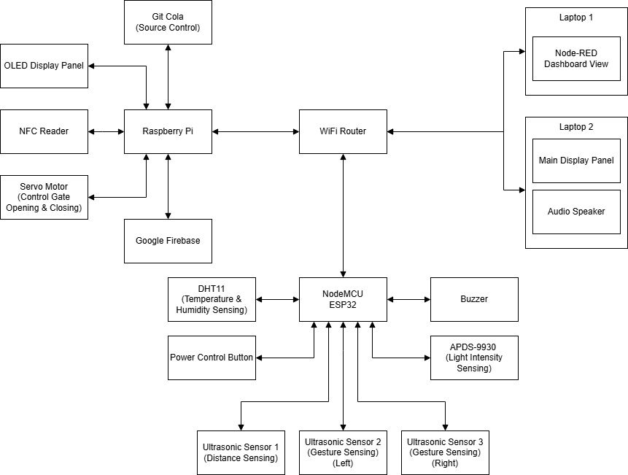
Architecture Diagram

Slide 7
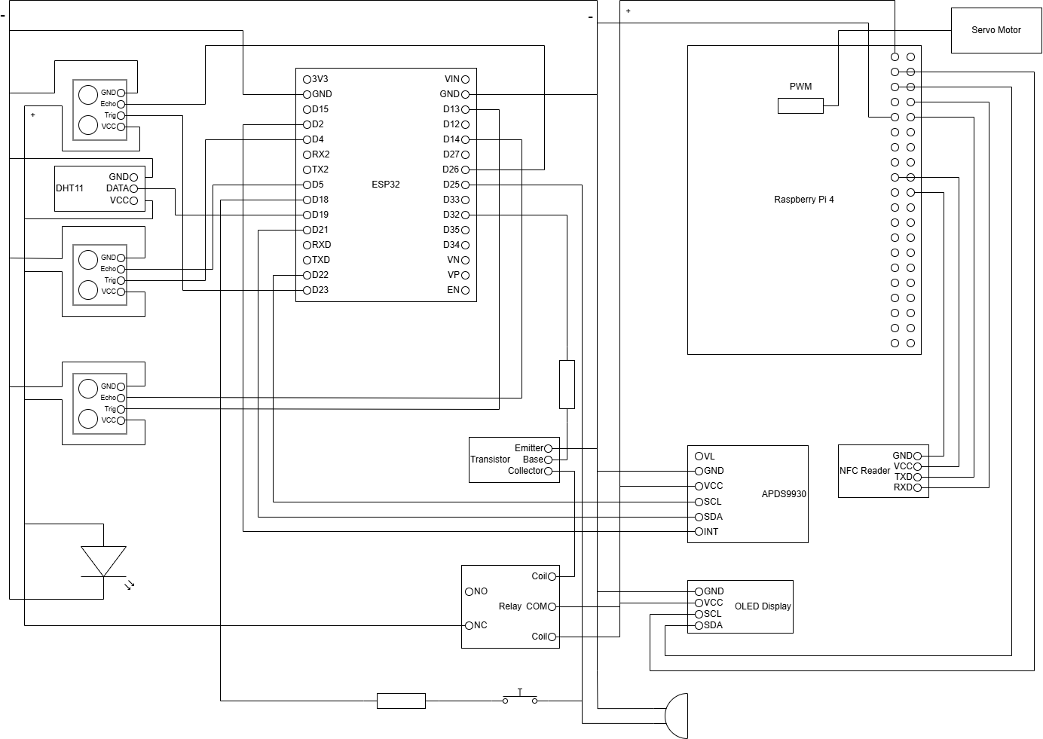
Schematic Diagram

Slide 8
Functional Modules Descriptions
01. Sensor Data Acquisition Module | Sensing light intensity, temperature, humidity at surrounding Sensing gesture or obstacle in front of the display panel Apply MQTT for sending requests and retrieving responses Update sensor information
02. Device Control Module | Sensors power control Monitor display power control via MQTT Accept MQTT message and adjust the display panel brightness

Slide 9
Functional Modules Descriptions
03. Guarded Entrance Hardware Module | Continuously scan for NFC card presence in read mode Perform card read and write operations Open the gate via servo motor Activate buzzer
04. Sensor Data Processing Module | Analyze brightness, humidity, temperature data at surrounding Collect the data of people close to the display panel Updates and retrieves data to firebase

Slide 10
Functional Modules Descriptions
05. Advertising Module | Full screen poster display and audio autoplay Swipe poster based on gesture Auto loop poster based on interval set at UI Switching oled display content
06. Guarded Entrance Process Module | Analyze incoming UI commands Update Firebase Check scanned card UID against Firebase records Decide whether to grant access or deny entry Trigger to control the motor or buzzer

Slide 11
Functional Modules Descriptions
07. Advertising User Interface Module | Manage poster records (create, update, delete) Manually set display brightness or switch to auto-brightness mode Define OLED display message rules for different environmental conditions Display power control toggle that sends MQTT commands to hardware View real-time sensor status

Slide 12
Functional Modules Descriptions
08. Guarded Entrance UI Module | Trigger card write or read mode for registration or scanning Display scan results and access status received from Firebase Send user data to process module for UID registration or updates Remove or update registered UID records
09. Report Module | Automatically determine the report type (daily, monthly, yearly) Retrieves and summarizes report data from Firebase Group and calculate the total people

Slide 13
Task Allocations
Smart Adaptive Display Panel
Lim Jun Wei
Ong Yi Xin
Chia Ming Yi
Sensor Data Acquisition Module
Device Control Module
Guarded Entrance Hardware Module
Sensor Data Processing Module
Advertising Module
Guarded Entrance Process Module
Advertising User Interface Module
Guard Entrance User Interface Module
Report Module

Slide 14
Prototype Video

Slide 15
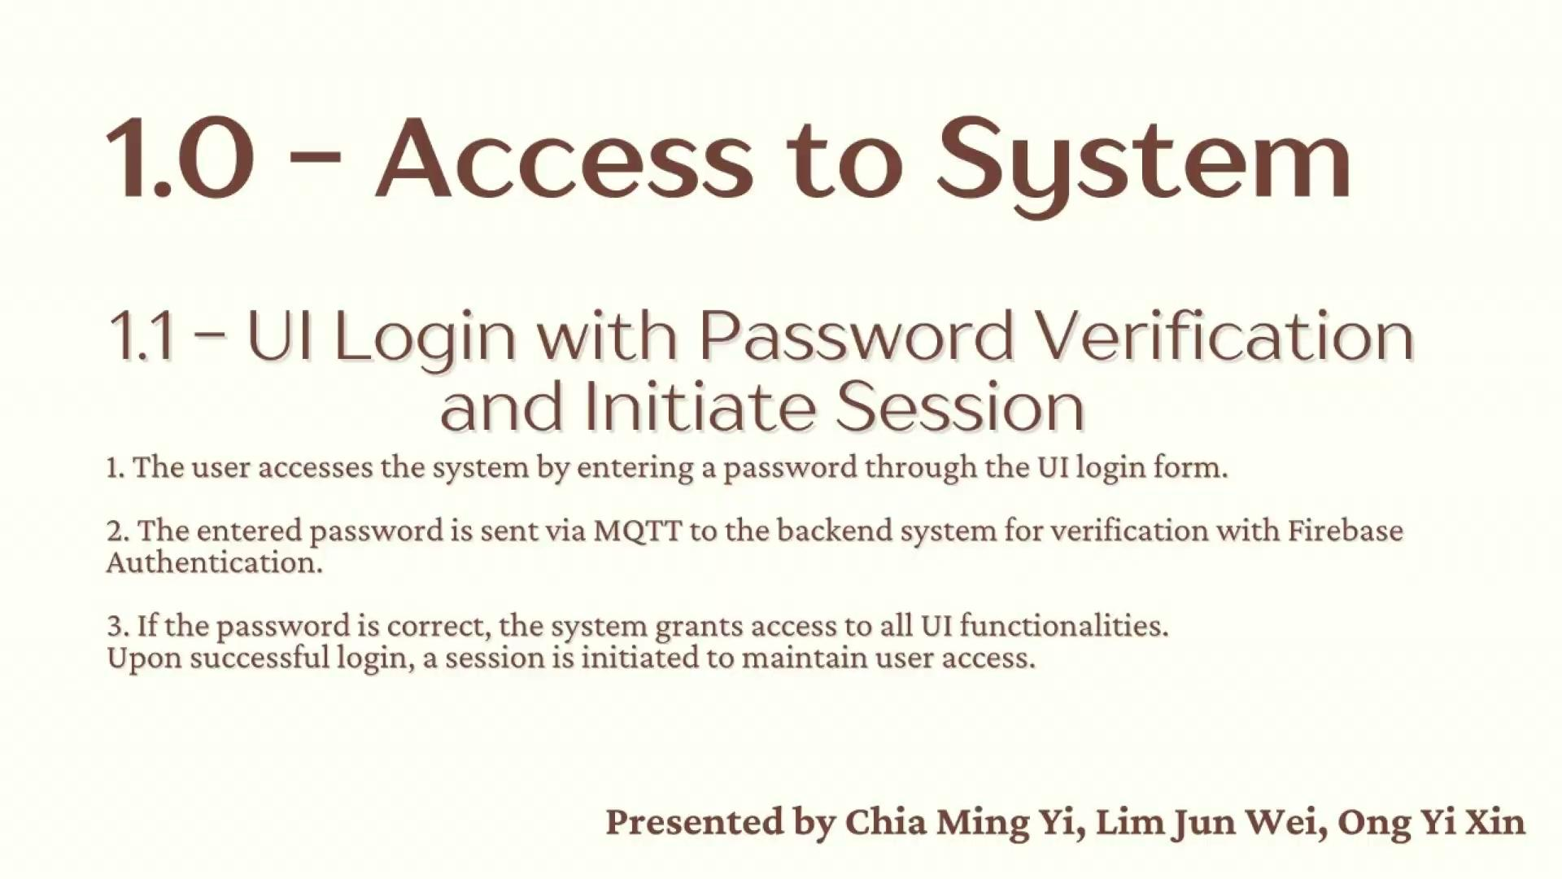
1.0 Access to System

Slide 16

2.0 System Control on Functions: ON or OFF

Slide 17
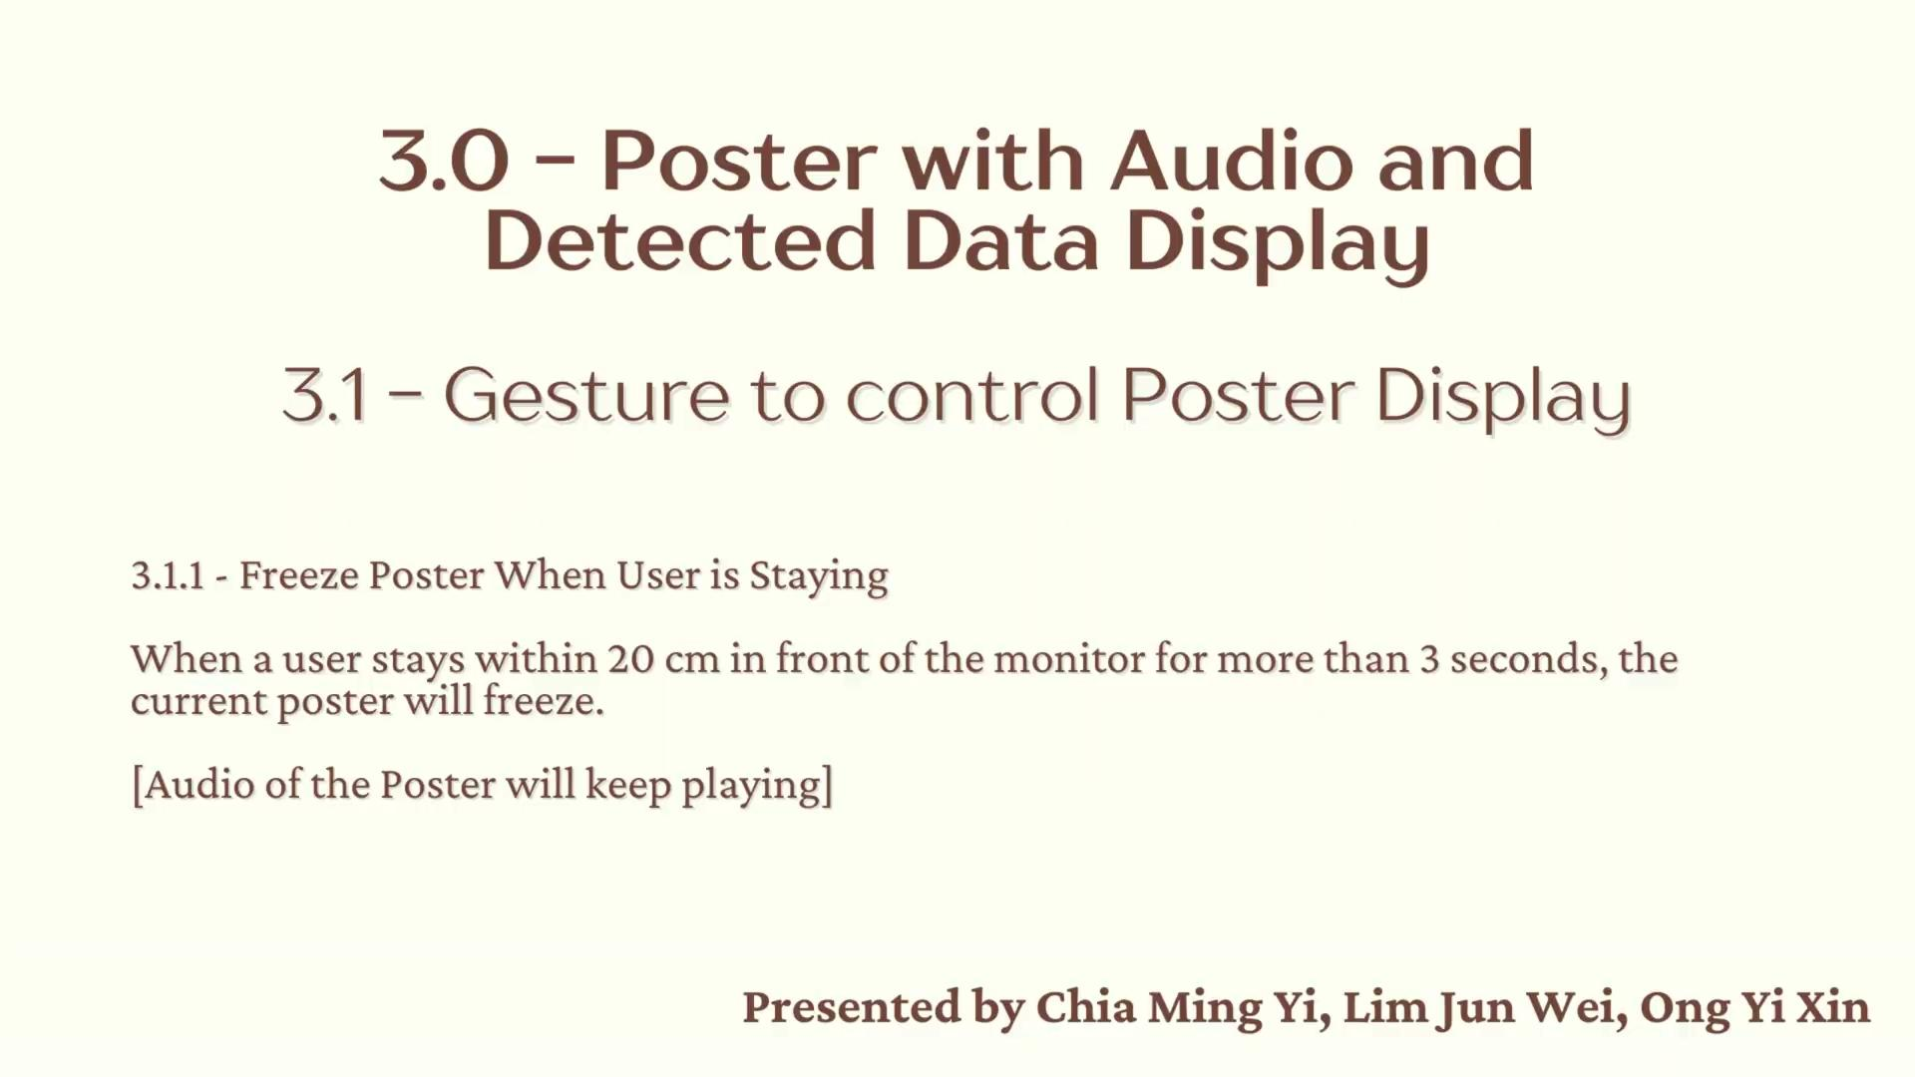
3.0 Poster with Audio and Detected Data Display

Slide 18
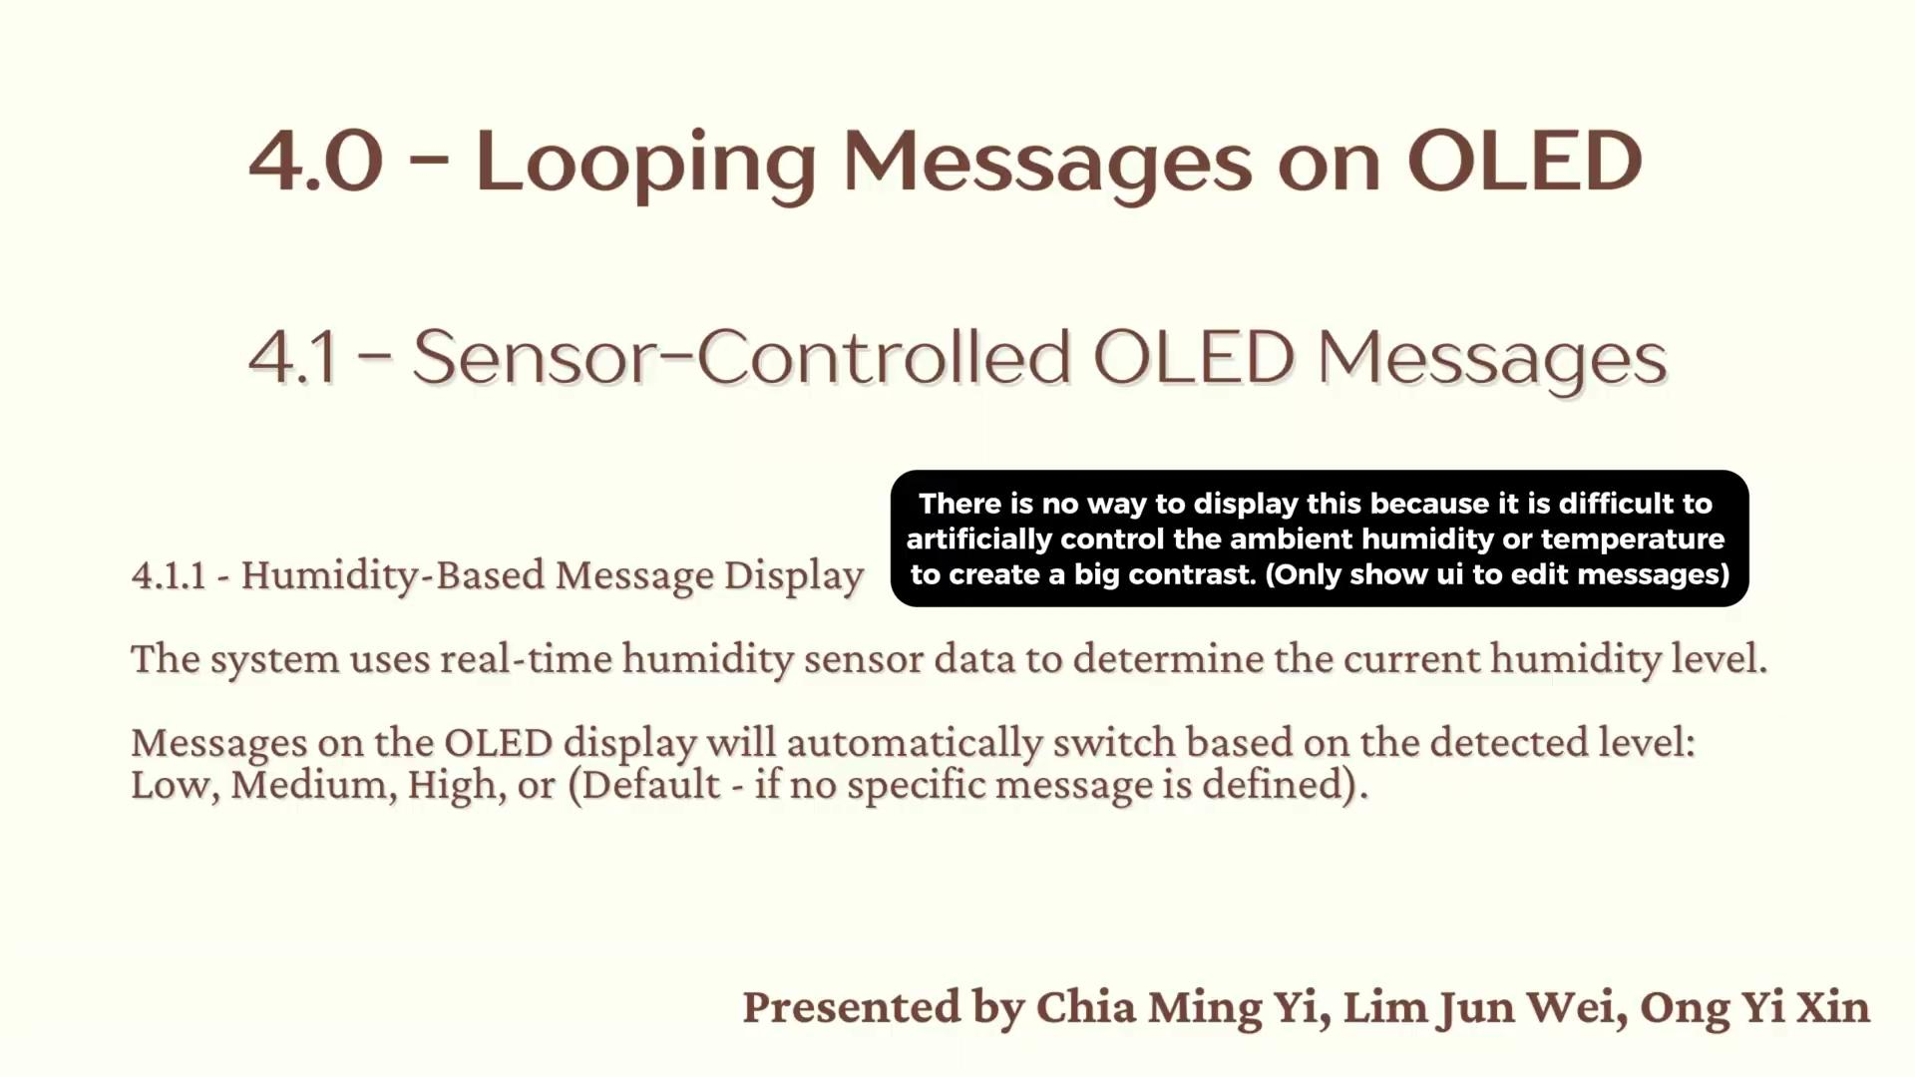
4.0 Looping Messages on OLED

Slide 19
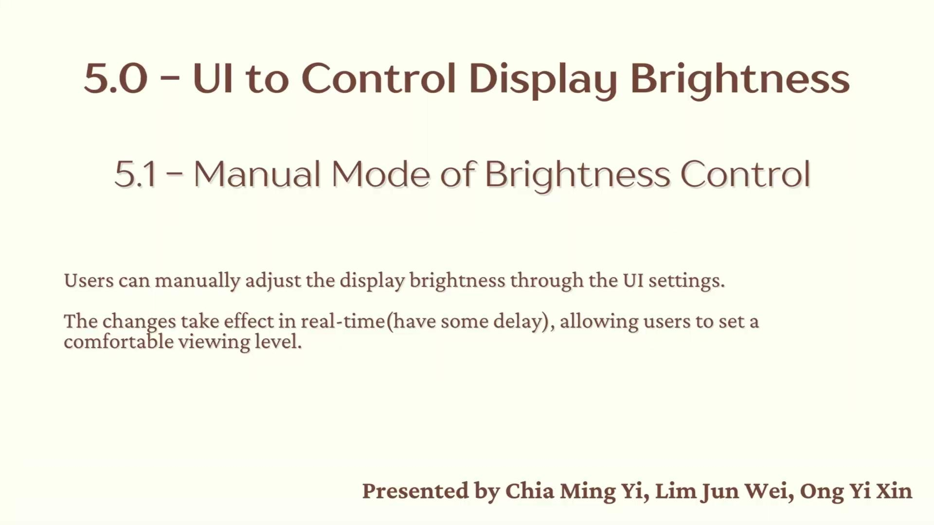
5.0 UI to Control Display Brightness

Slide 20
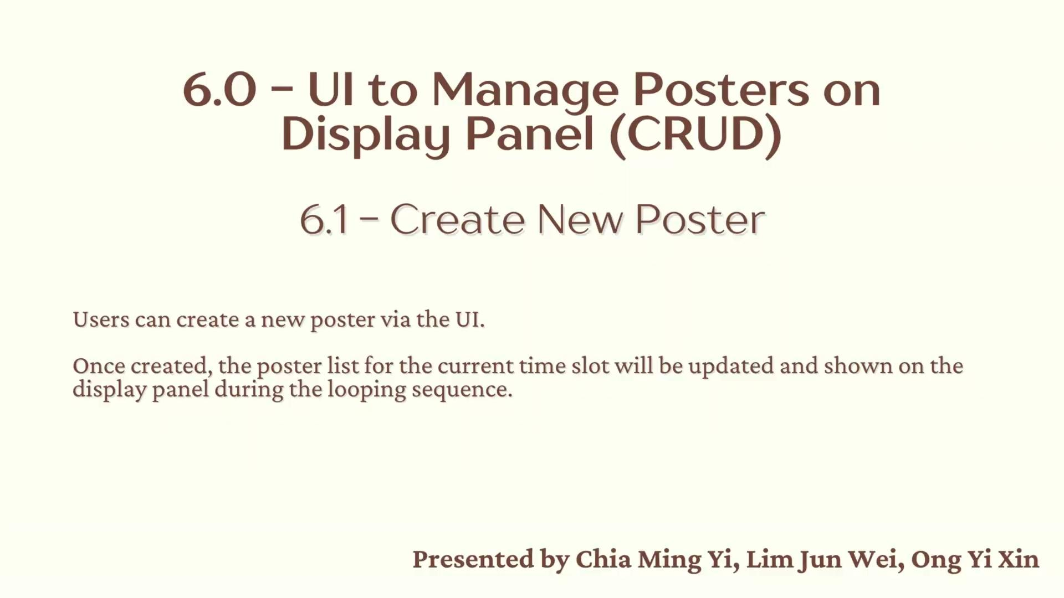
6.0 UI to Manage Posters on Display Panel (CRUD)

Slide 21
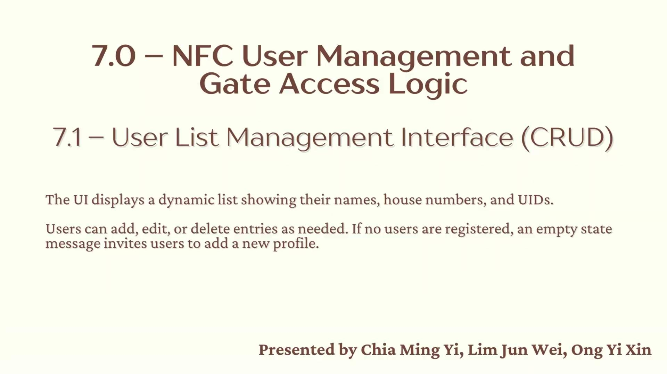
7.0 NFC User Management and Gate Access Logic

